Slide 1

Exploring COVID-19 Impacts Across Different Regions
Giorgi Zukakishvili
DaSean Kornegay
Klarisa Dani
01

Slide 2
Outline
Introduction
Europe and North America
China and East Asia
India and Sub-Saharan Africa
Latin America
Comparison of Regions
Implications for Future Pandemics
Conclusion
Q&A

Slide 3
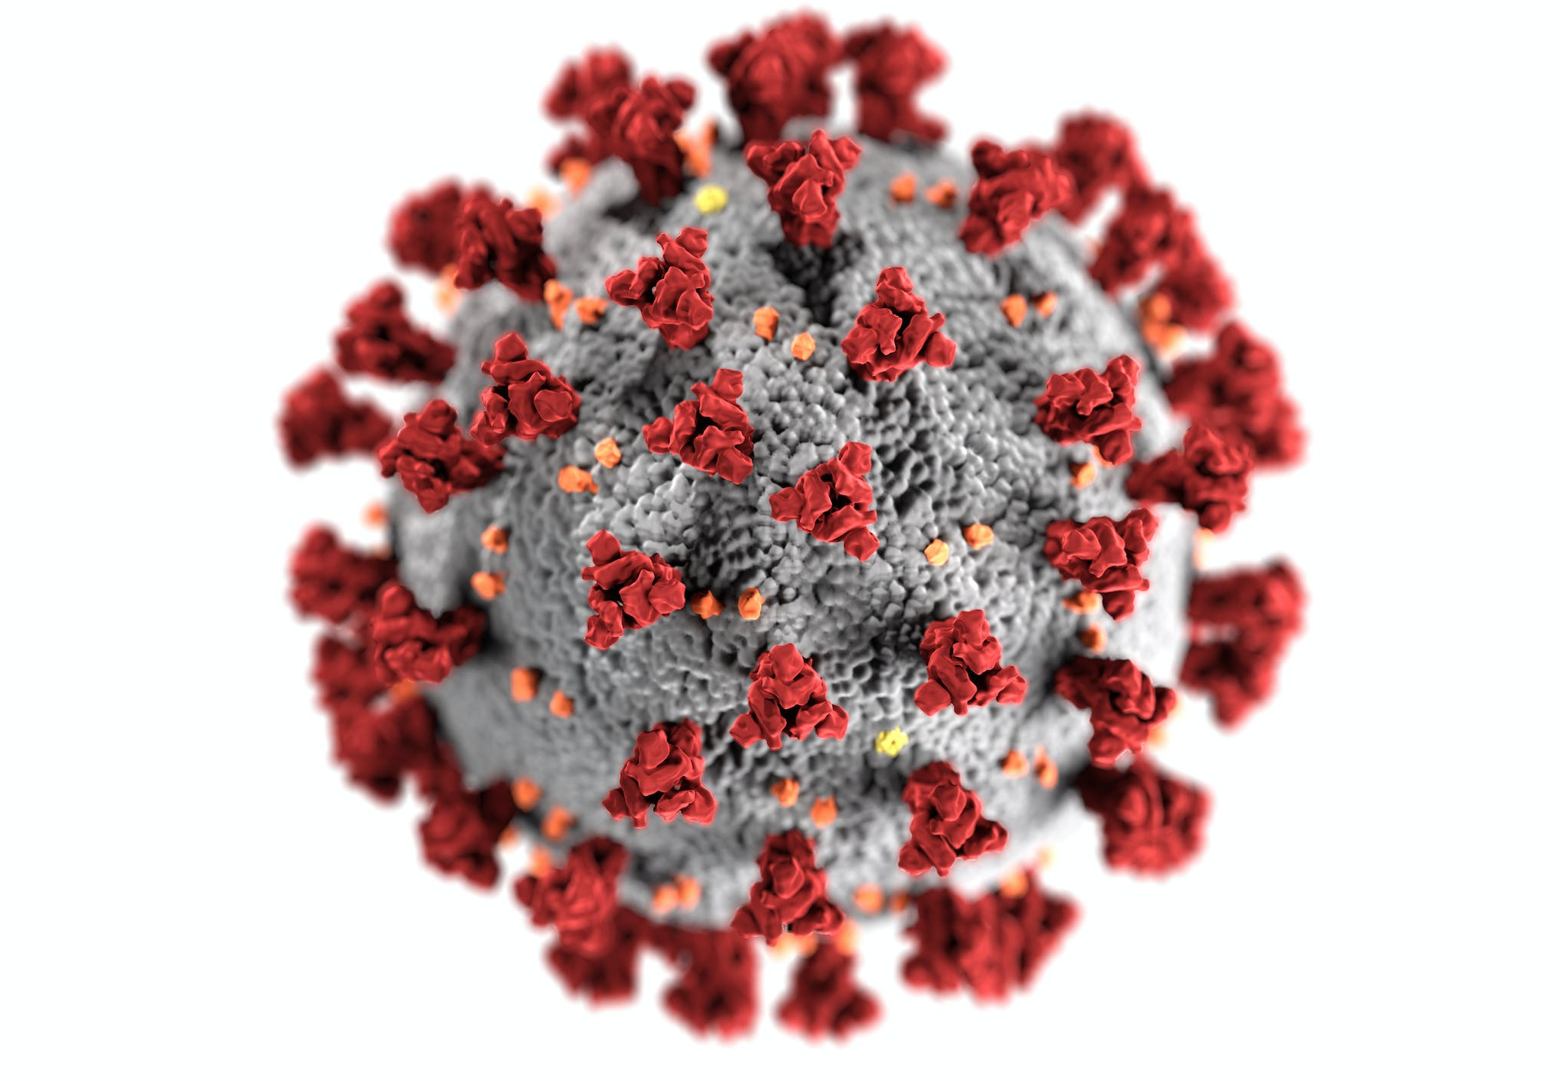
Introduction
COVID-19 has been a significant challenge for humanity, affecting every corner of the globe.
The severity and scope of the pandemic have varied greatly across regions.
This presentation will focus on four regions:
Europe and North America
China and East Asia
India and Sub-Saharan Africa
Latin America
We will cover:
Policy Responses
Demographic factors
Cultural and political systems that have contributed to the varying experiences of these regions.

Slide 4
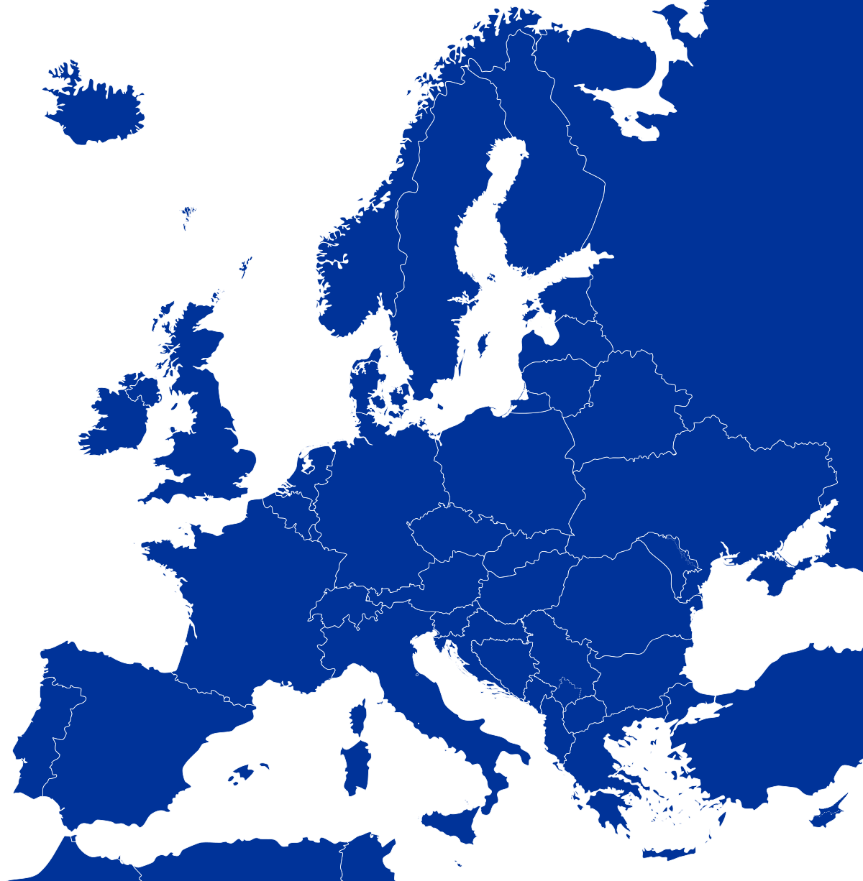
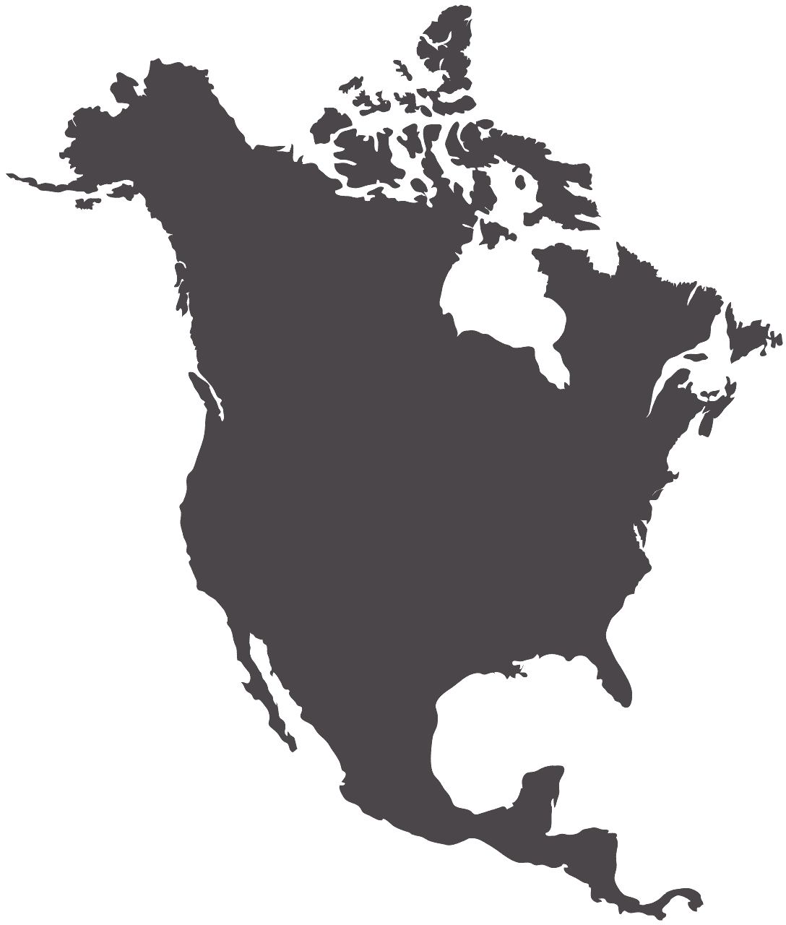
Europe & North America

Slide 5

Political Factors
1
2
3
Policy Response Variations
Varied; Some countries implemented strict lockdowns, others relied more on individual responsibility.
Impact of Policy Effectiveness Public compliance, capacity for testing and contact tracing, and availability of healthcare resources have impacted policies
Importance of Vaccine Distribution Some countries were more successful than others in vaccinating their populations.

Slide 6

Demographical Factors
1
2
3
Aging Population and Mortality
The aging population has been a significant factor in higher mortality rates.
Disproportionate Impact on Marginalized Communities Communities of color and low-income populations have been disproportionately impacted; due to pre-existing health disparities and inequalities.
Other Demographic Factors Occupation and living arrangements have also played a role in the pandemic experience.

Slide 7
Culture and political systems
1
2
3
Individualism and Public Health
Individualistic cultures and political systems have contributed to challenges in implementing and enforcing public health measures.
Politicization and Misinformation Led to confusion and misinformation among the public.
Social Media and Pandemic Social media and technology has had a huge influence on the spread of information and the development of public opinion

Slide 8


1 out 55
1 in 55 people have died from COVID-19 in North America and Europe combined
60%
A survey conducted in the United States in 2022 found that over 60% of respondents reported experiencing pandemic-related anxiety and depression. (Source: Kaiser Family Foundation)
123 million
In many European countries, the COVID-19 mortality rate for those aged 80 and over was 100 times higher than for those under the age of 40. (Source: European Centre for Disease Prevention and Control)
.

Slide 9
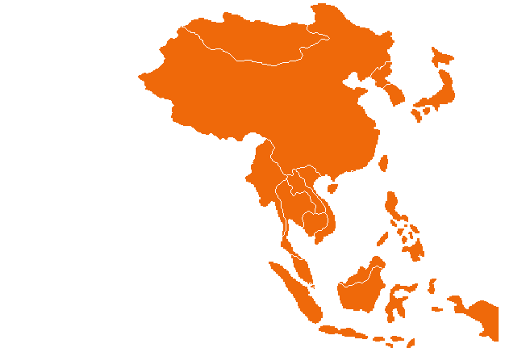
China & East Asia

Slide 10
Political Factors
1
2
3
Lockdown Measures
China’s lockdown measures reduced COVID-19 transmission by reducing the reproductive number (R0) from 2.35 to 1.05 within a month.
Technology Adoption In Taiwan and South Korea, comprehensive testing and contact tracing reduced case numbers and fatality rates.
Widespread Testing and Tracing Many East Asian countries implemented mobile phone tracking and QR codes for contact tracing and health declarations to support policy response.

Slide 11

Demographical Factors
1
2
3
Lower Proportion of Older Adults
The proportion of older adults in China and East Asia is lower than in Europe and North America, which may have contributed to lower mortality rates.
Healthcare Infrastructure Investment Countries in East Asia have invested heavily in healthcare infrastructure and public health measures, leading to better preparedness for health emergencies.
Mask-wearing Culture The culture of wearing masks in East Asia, even before the pandemic, has been cited as a factor in reducing the spread of COVID-19.

Slide 12
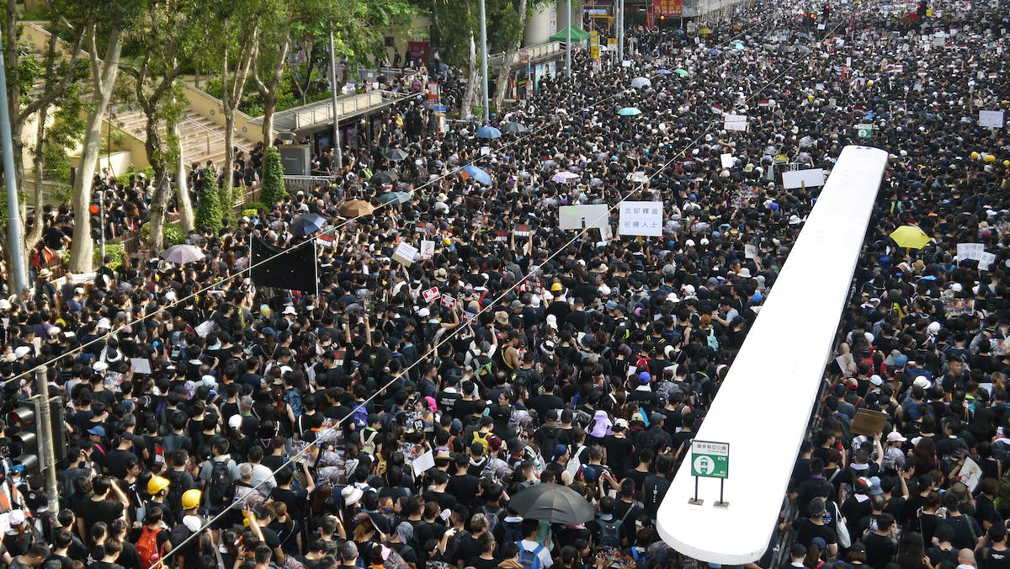
Culture and political systems
1
2
3
Emphasis on Social Harmony
Confucian values emphasize the importance of social harmony and collective well-being
May have facilitated the implementation of strict policy measures.
Swift and Decisive Action The political systems in China and South Korea, which allowed for swift and decisive action, were able to quickly implement policies to control the spread of the virus.
Trust in Government and Authority The trust in government and authority in some East Asian countries may have facilitated compliance with public health measures.

Slide 13
1 out 820
China has reported 99,240,488 confirmed cases of COVID-19, resulting in 120,912 deaths, since January 3, 2020. These numbers were reported to the World Health Organization.
1.5%
Japan has reported over 1 million COVID-19 cases and 15,000 deaths, but its mortality rate is lower than that of Europe and North America.
10 Million & 1,905 deaths
Japan has reported over 1 million COVID-19 cases and 15,000 deaths, but its mortality rate is lower than that of Europe and North America.
.

Slide 14
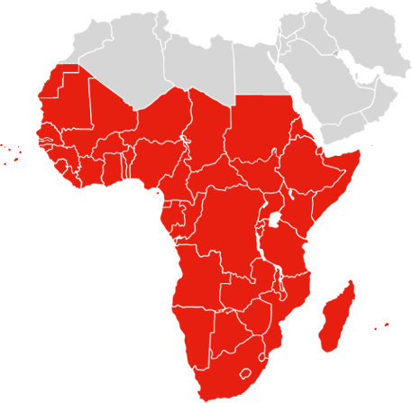
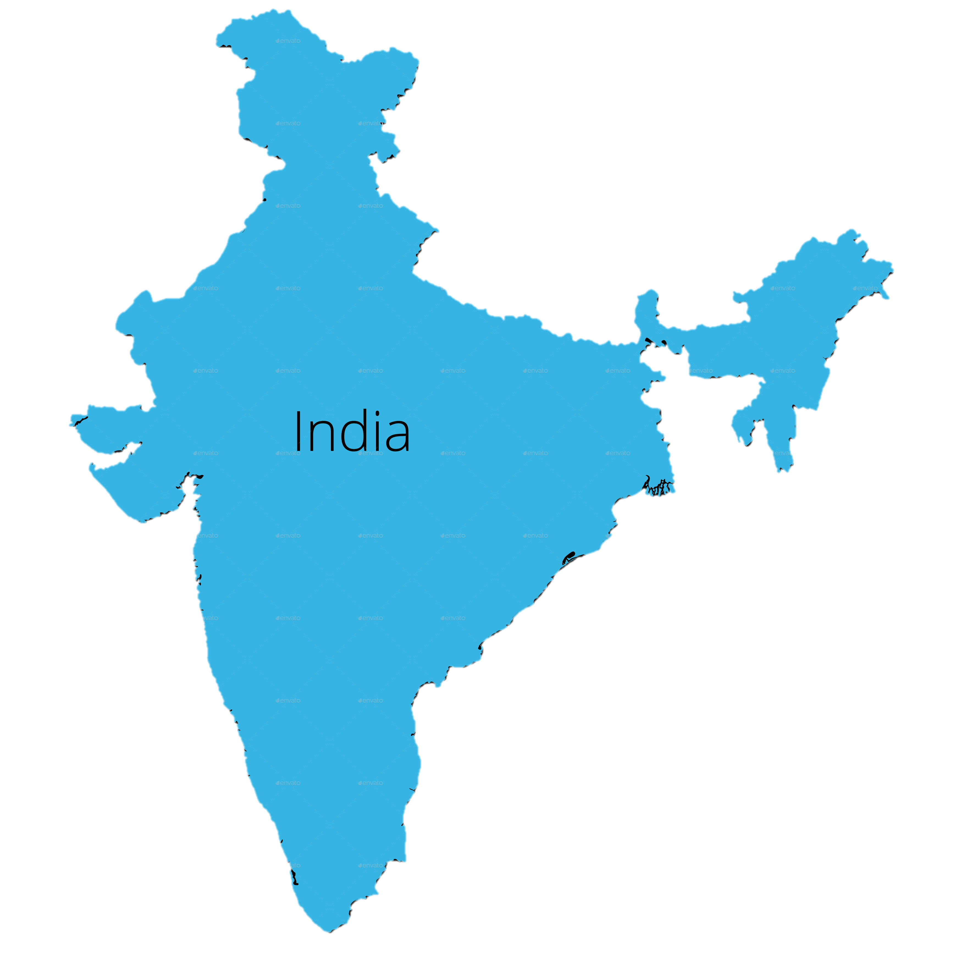
India & Sub-Saharan Africa

Slide 15
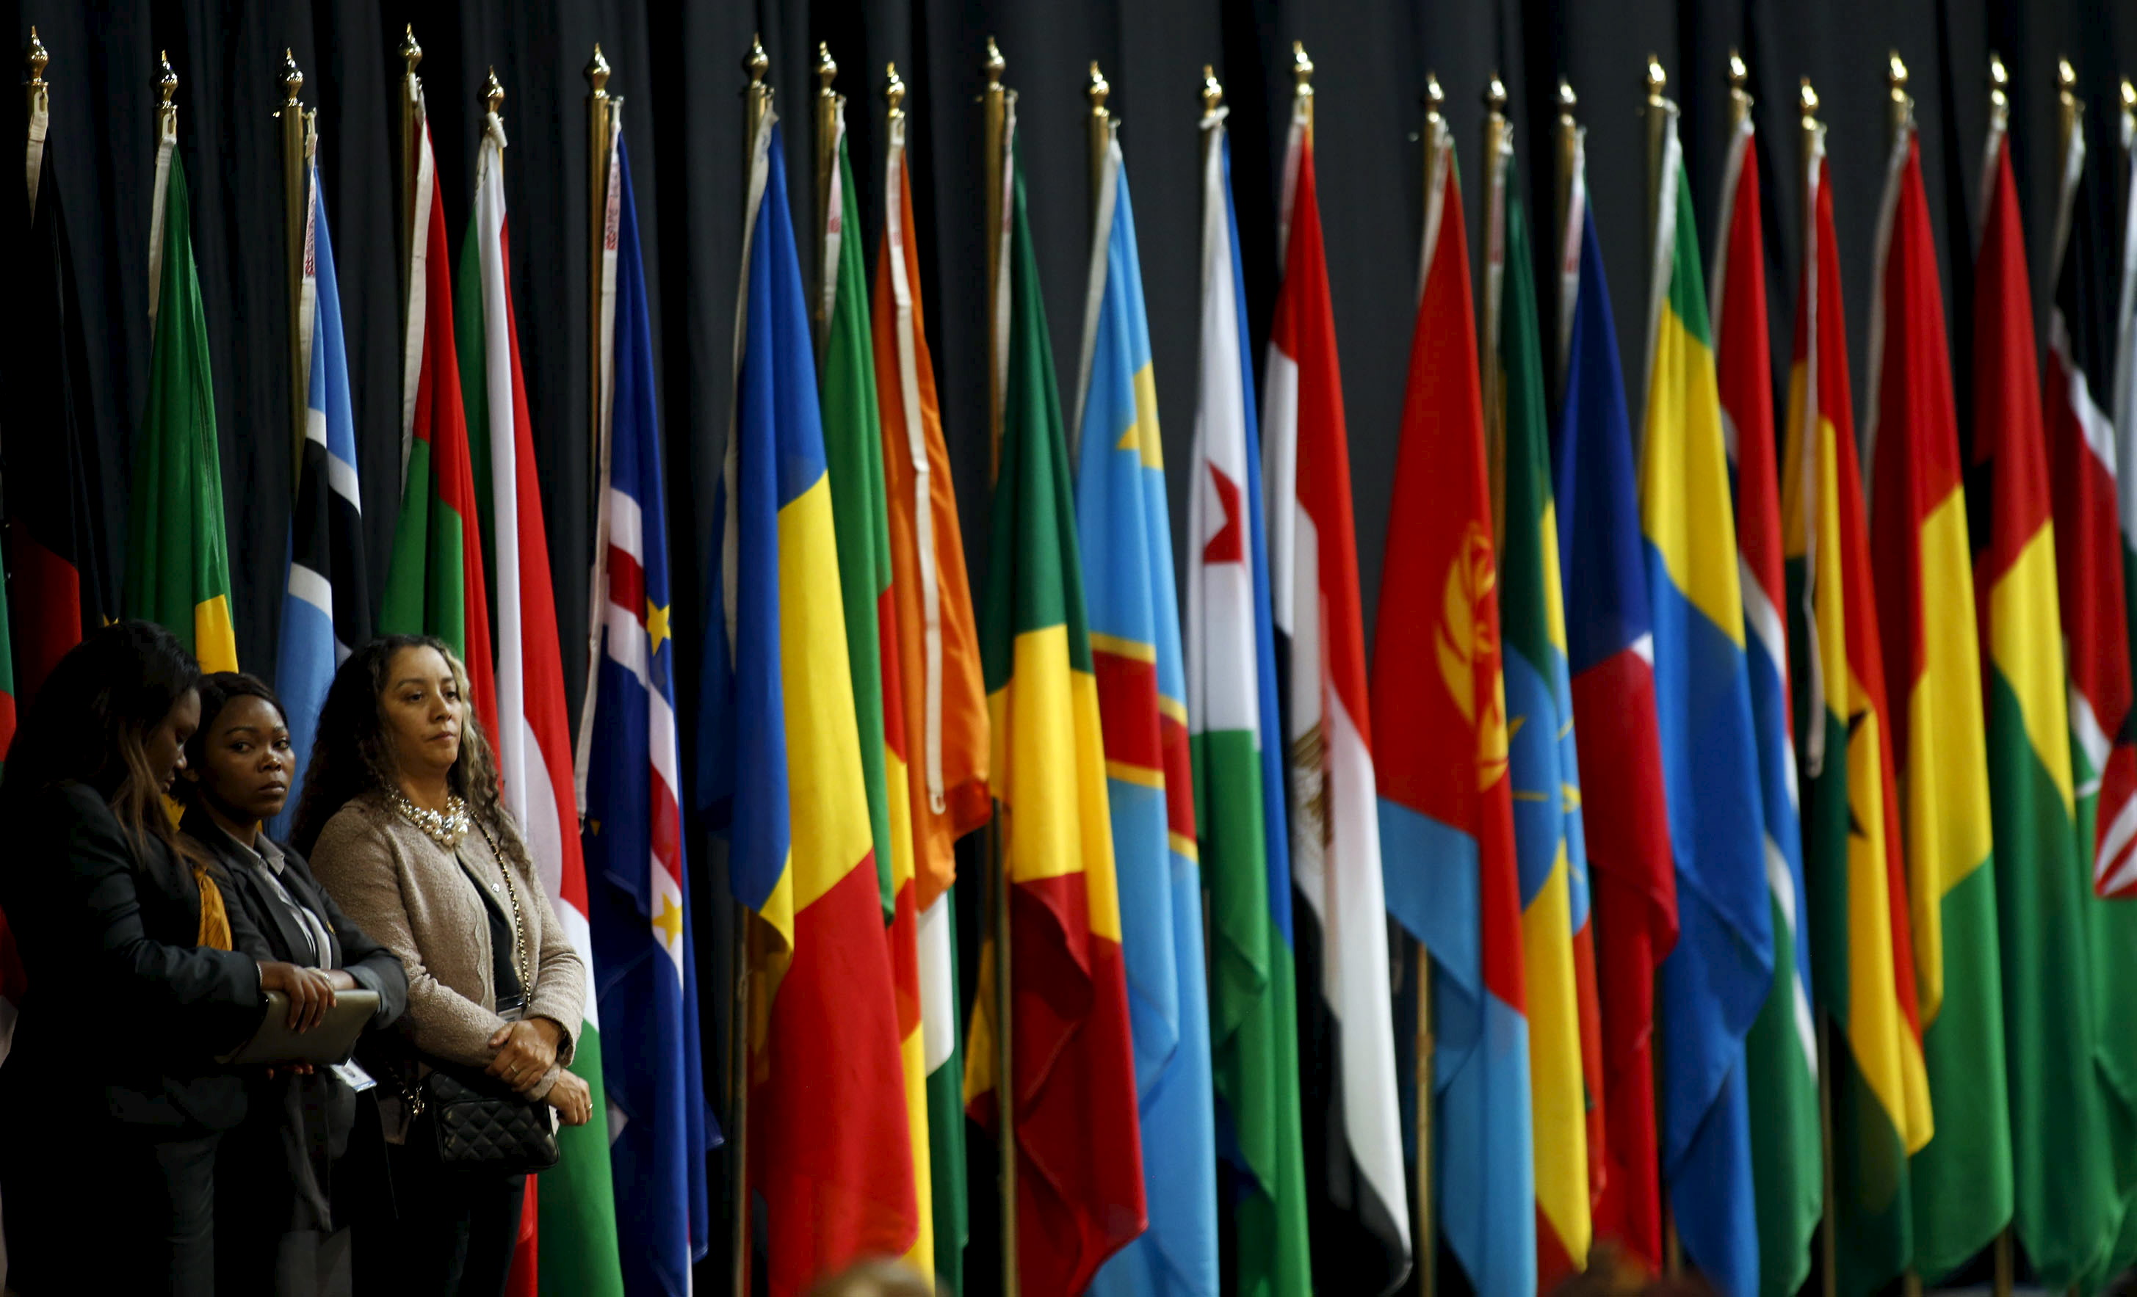
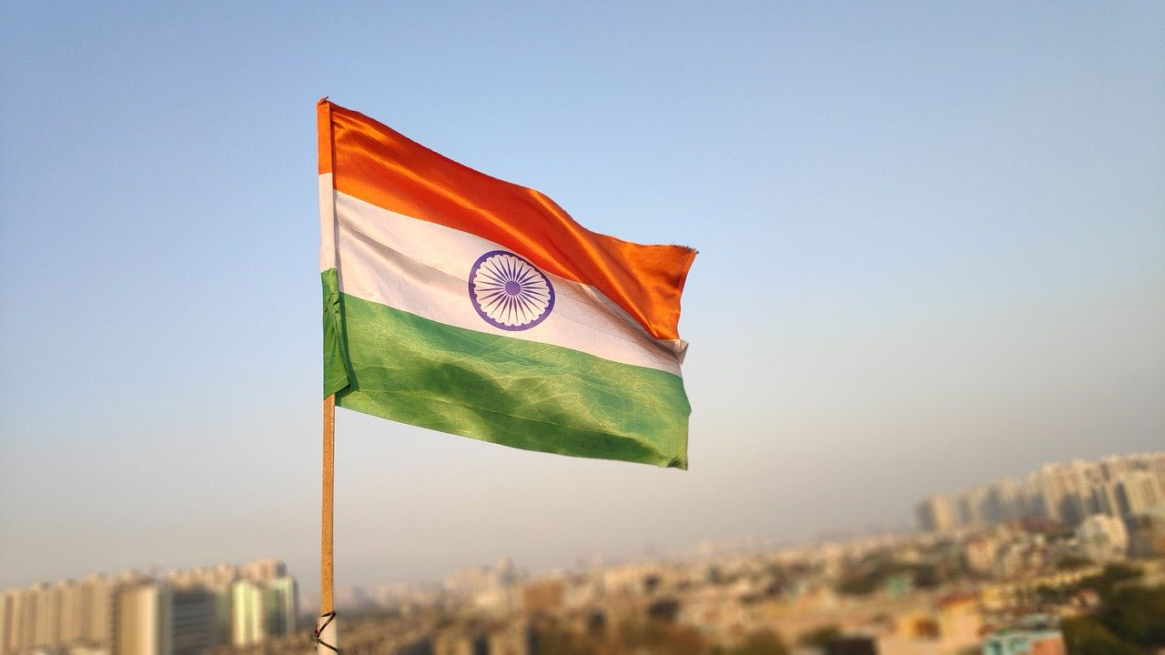
Sub-Saharan Africa includes 46 countries located south of the Sahara Desert, with a population of over 1 billion people
Diverse region with numerous ethnic groups, languages, and cultural traditions
India is the Most populous country in the world
Rich history shaped by colonialism, independence struggles, and economic development
Policy
Demographics
Culture and political system
Healthcare & Vaccines
Economic impact

Slide 16
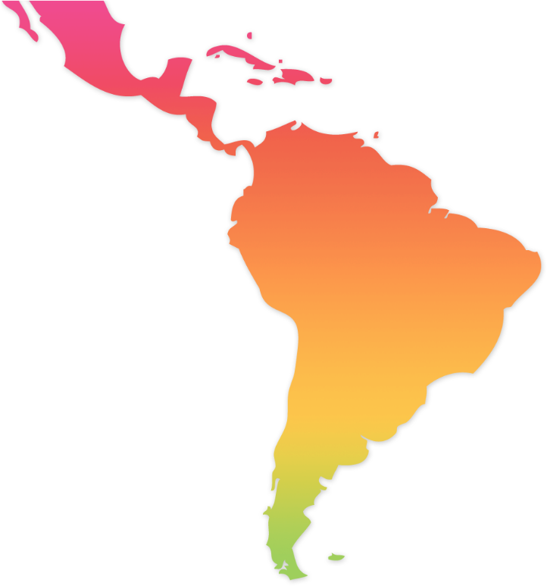
Latin America

Slide 17
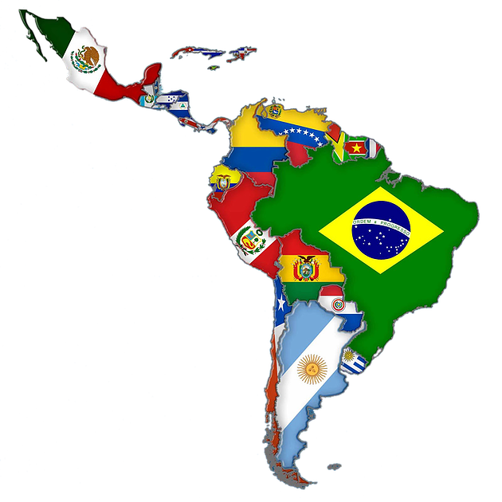
Latin America
Diverse region with a population of over 650 million people
The region has a mix of democratic and authoritarian governments
Latin America has faced challenges in implementing effective policies to contain the spread of Covid-19
Access to quality healthcare has been a major challenge during the Covid-19 pandemic
The pandemic has had a significant economic impact on Latin America
Policy
Demographics
Culture and Political System
Healthcare & Vaccines
Economic Impact

Slide 18
Comparison of Regions
18
18

Slide 19

Comparison of Regions
The COVID-19 pandemic has impacted regions around the world differently.
Europe and North America were hit hard early on but have since seen a decline in cases and deaths due to large-scale vaccination programs.
China and East Asia implemented strict measures early on and have been relatively successful in containing the virus, but vaccination rollout has been slower.
India and Sub-Saharan Africa have struggled with limited healthcare resources and infrastructure, and the vaccination rollout has been slow.
Latin America has also been hit hard by the pandemic, with some countries struggling with limited resources and others deploying successful vaccination programs.
Factors such as healthcare infrastructure, economic development, and government response have all played a role in determining the outcomes of the pandemic in different regions.

Slide 20
Implications for Future Pandemics
20
20

Slide 21
Implications for Future Pandemics
Preparedness and proactive measures are crucial to contain the spread of future pandemics.
Governments should invest in healthcare systems and ensure adequate resources are in place to respond to a pandemic.
Cooperation and coordination among countries and international organizations are important to combat pandemics.
Addressing inequalities in access to healthcare and economic opportunities is crucial to reduce the impact of future pandemics on vulnerable groups.
Effective communication and transparency are necessary for managing pandemics.

Slide 22
Conclusion

Slide 23
Conclusion
COVID-19 pandemic experiences varied across different regions
Implications for future pandemics include early action, effective communication, and collaboration between nations
Developing countries need stronger healthcare systems and efforts to address vaccine disparities
Pandemics require a coordinated global response
Learning from successes and failures of COVID-19 pandemic can
better prepare us for future health crises

Slide 24
Q&A
Any Questions?
Discussant: Milos

